Slide 1
CS6907-13: Big Data and Analytics
Fall 2015
Stephen H. Kaisler, D.Sc.
Lecture 2 –Graph Analytics

Slide 2
Graph Theory - I
A graph is defined as a set of nodes and a set of lines that connect the nodes, written mathematically as G=(V,E) or G(V,E).
The nodes in a graph represent persons (or animals, organizations, cities, countries, etc.) and the edges (lines) represent relationships among them.
  The line between persons a and b is represented mathematically like this: (a,b).
  The graph here contains these edges: (a,b), (a,e), (b,d), (a,c), and (d,c).
  A subgraph of a graph is a subset of its points
  together with all the lines connecting members
  of the subset. (subgraph = {a, b,c,d})
The degree of a point is defined as the number of lines incident upon that node: degree(a) = 3
CSCI6907-13 Big Data and Analytics
2-<number>
10-<number>

Slide 3
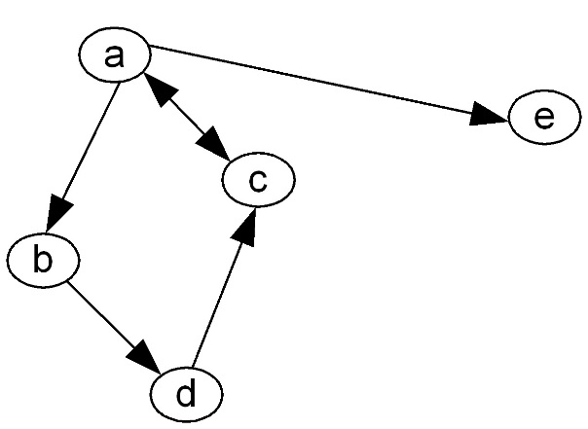
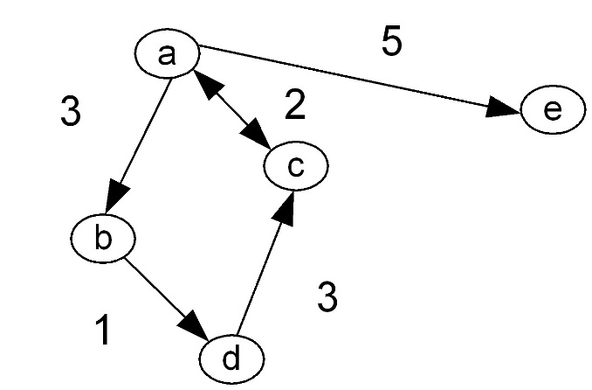
Graph Theory - II
If a node has degree 0 it is called an isolate.
In a directed graph, the edges have direction (indicated by arrow heads)
If a line connects two points, they are said to be "adjacent".
The two points connected by a line are called endpoints.
  An edge that originates or terminates at a given point is "incident" upon that point.
  Two edges that share a point are also said to be incident.
A weighted graph has values assigned to the edges.
2-<number>
10-<number>

Slide 4
Graph Theory - III
In a directed graph, a point has both indegree and outdegree:
  The outdegree is the number of arcs from that point to other points.
  The indegree is the number of arcs coming in to the point from other points.
A path is an alternating sequence of points and lines, beginning at a point and ending at a point, and which does not visit any point more than once.
  Two paths are point-disjoint if they don't share any nodes.
  Two paths are edge-disjoint if they don't share any edges.
  A walk is a path with no restriction on the number of times a point can be visited.
  A cycle is a path except that it starts and ends at the same point.
  The length of a path is defined as the number of edges in it.
  The shortest path between two points is called a geodesic.
CSCI6907-13 Big Data and Analytics
2-<number>
10-<number>

Slide 5
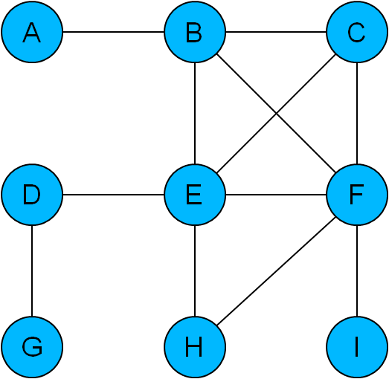
Graphs: Cliques
A clique is a complete connected subgraph
  In a clique, every node is connected to every other node
  B, C, E and F form a clique of size 4
  E, F and H form a clique of size 3
  A, D, G and I are not part of any clique
Subgraphs identified as cliques are interesting because they
  are as tightly connected as possible
  are ‘modules’ in the graph
  indicate through exclusion sections of the graph that are not so tightly connected
2-<number>

Slide 6
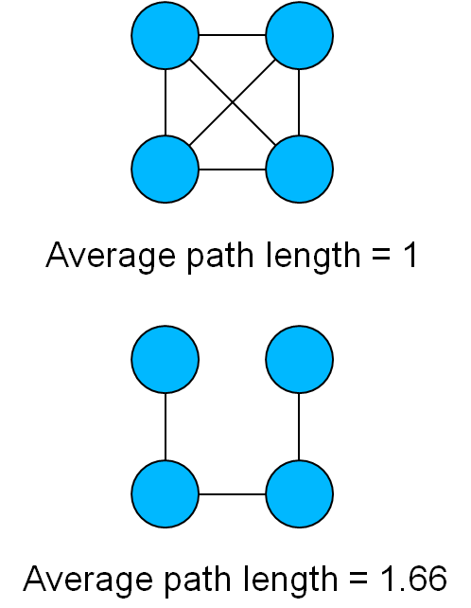
Graphs: Global Metrics
The average path length of a graph is the average of the shortest path lengths between all pairs of nodes in a graph
Also known as diameter or average shortest path length
2-<number>

Slide 7
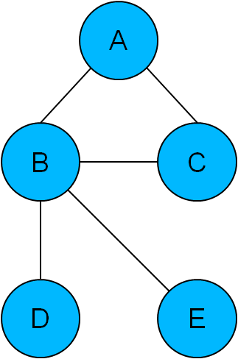
Graphs: Average Path Length
Shortest paths are
  AB, AC, ABD, ABE, BC, BD, BE, CBD, CBE, DBE
Lengths
  1, 1, 2, 2, 1, 1, 1, 2, 2, 2
  Average path length: 1.5
In graphs with a low average path length, transfer of information between nodes takes place rapidly
Average path length is generally proportional to the size (N) of a network
  In small-world networks it is proportional to
  log N
  In scale-free networks it is proportional to
  log N
2-<number>

Slide 8
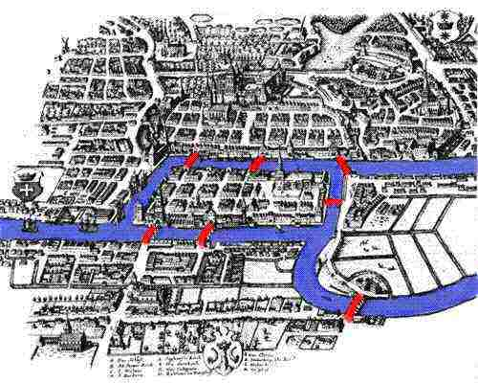
Early Graph Problem
Bridges of Konigsberg:
  Is it possible to cross all of the bridges in the city without crossing a single bridge twice?
  Euler realised that
  this problem could
  be represented as
  a graph
  Does this graph have a path covering every edge without duplicates? (an Euler walk)
  In order to have such a path, the graph must have either zero or two nodes with an odd number of edges
  It has four, therefore no!
Q: Who is Leonhard Euler??
CSCI6907-13 Big Data and Analytics
2-<number>
10-<number>

Slide 9
Network Definition
A network is a connected graph
A spanning tree of a network is a graph that:
  Connects all the vertices
  Contains no circuits
Properties:
  In a network with N vertices, every spanning tree has exactly N-1 edges
  Given a set of N-1 edges that is acyclic, then it forms a spanning tree
  Given a set of N-1 edges that connect all vertices, then it is acyclic
  A network with M vertices and N-1 edges has M > N-1.
  The redundancy of the network, R = M-N+1.
  If R = 0, the network is a tree.
  If R > 0, there may be several spanning trees.
CSCI6907-13 Big Data and Analytics
2-<number>
10-<number>

Slide 10
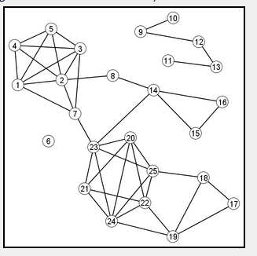
Clusters
Clusters are important features of many problems:
  To the extent that Web builders tend to link to sites similar to their own sites, clusters of interlinked Web pages represent collections of content about meaningful subtopics.
Clusters are hard to define mathematically.
Clusters are:
  {1,2,3,4,5,7}
  {20,21,22,23,24,25}
  {14,15,16}
  S={9,10,11,12,13} is arguably not a cluster, because the density of that induced subgraph is relatively low.
Ex: Finding clusters is one way to discover meaningful collections of Web pages.
2-<number>
Notes:
4,5,3,2,1,7 -> network
Can have problems where networks are not communicating with each other
Clusters are partial networks
Spanning trees will traverse network but not return to the original node
Igraph contains ‘pagerank’ function.

Slide 11
Some Graph/Network Properties
Derived from mathematical properties of graphs
Metric | Description
Degree (in, out) | The number of edges to/from a node; a measure of the richness of the node’s participation in the network.
Betweenness | The number of paths passing through a node between a node A and a set of other nodes B.
Path Length | Number of paths from one node A to another node b; the shortest, mean, and longest paths.
Centrality | A measure of the importance of the node based on measuring the number of neighbors to reachable within some number of edges.
Closeness | Measures autonomy or independence of a node relative to other nodes.
Prestige | Measured by the number of in-links: P_{i} = IN_{i}/(n-1), where IN is the number of in-links for node i. Prestige is standardized to a value between 0 and 1.
10-<number>
10-<number>

Slide 12
Graphs/Networks: Centrality
Centrality:
  A node-level metric representing its position in the network
Degree Centrality: number of distinct relationships or links a node has:
Undirected Graph:
  C_{U}(i) = Σ x_{ij}; j =1,N and i /= j
  C_{U}(i) = C_{U}(i)/(N-1) normalized value
Directed Graph:
  Differentiate by "in" and "out" connections based on which way power & influence flow
  Centrality is based only on the out connections to other nodes
  C_{D}(i) = Σ x_{ij}; j =1,N & i /= j & i → j (out)
  C_{D}(i) = C_{D}(i)/(N-1) normalized value
2-<number>

Slide 13
Graphs/Networks: Centrality
Betweenness Centrality: measures control or broker ability of a node
  Maximum "betweenness" is for an intermediary node in a star network
  Let p_{jk} be the # of shortest paths between nodes j and k (there may be many)
  Let p_{jk}(i) be the number of shortest paths passing through node i
  Then, C_{B}(i) = Σ p_{jk}(i) / p_{jk} , j < k
  Normalized version: C_{B}(i) = (2 * Σ p_{jk}(i) / p_{jk} )/(n-1)(n-2), j < k
Closeness: nodes that can reach other nodes via the fewest intermediaries are relatively independent/autonomous of others
  Intermediaries serve as attenuators and filters
  Let the shortest distance from node i to node j be d(i,j)
  C_{c}(i) = (n-1)/ Σ d(i,j), j = 1,N
2-<number>

Slide 14
Graphs/Networks: Prestige - I
A prestigious node is one which is the object of extensive ties as a recipient.
Degree Prestige:
  A node is prestigious if it receives many in links from adjacent nodes
  So, P_{D}(i) = d_{I}(i)/(n-1), where d_{I}(i) is # of in links for node i
Proximity Prestige:
  Considers all nodes that can reach node i
  Proximity is defined as closeness or distance of other actors to i.
  Let I_{i} be the set of nodes that can reach node i
  P_{P}(i) = Σ d(i,j)/ |I_{i}|, j ε I_{i}
  Consider also the ratio of the nodes reaching i and their average distance
  P_{P}(i) = |I_{i}|/(n-1)/Σ d(i,j)/ |I_{i}|, j ε I_{i}
  Where the numerator is the proportion of nodes that reach i
2-<number>

Slide 15
Graphs/Networks: Prestige - II
In the previous two calculations, every node was equal.
But, suppose we assign some measure of importance to each node, e.g., a rank such as a CEO
If a node’s circle of influence is full of prestigious actors, then the node’s own prestige is also high.
Rank prestige P_{R}(i) is defined as a linear combination of links that point to i:
    P_{R}(i) = Σ A_{ji}P_{R}(j), j = 1, n
where A_{ji} = 1 if node j points to node I
Matrix A is the adjacency matrix for the network
An actor’s rank prestige is a function of the rank prestige of the actors whose choose that actor.
2-<number>
Notes:
Edge can have a label as an attribute, degree of -------,

Slide 16
Applications of Graph Analytics
Hyperlinks (the Web)
Social graphs (Facebook, Twitter, LinkedIn,…)
  We will discuss Social Network Analysis below
Email logs, phone call logs , messages
Commerce transactions (Amazon purchases)
Road networks
Communication networks
Protein interactions
… more and that’s for sure
So, to be proficient in Graph Analytics, you need to understand graph theory and network theory
2-<number>

Slide 17
Converting a Graph to a Matrix - I
Represent a graph as a matrix:
  Row labels and Column labels are nodes of graph
  Cell values are # edges connecting Node r (a row label) to Node c (a column label)
Given the following graph, compute the matrix representation:
For each node, label a row and a column in the matrix
For each node, identify the edges to other nodes in the graph
Place 1 in the row = src node and column = destination node
Ex: E goes to B, C, D, F, H
2-<number>
Notes:
Undirected graph treated as bi-directional

Slide 18
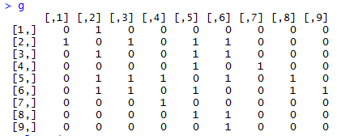

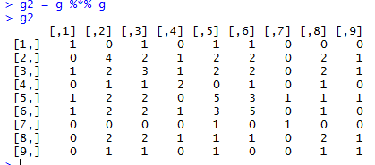
Matrix Calculations - I
a
b
c
d
e
f
g
h
i
a
1
b
1
1
1
1
c
1
1
1
d
1
1
e
1
1
1
1
1
f
1
1
1
1
1
g
1
h
1
1
i
1
So, the reachability of node b to itself [2,2] in g2 is 4.
Convince yourself this is true.
2-<number>
Notes:
This is an example of bidirectional/undirected graph in matrix form
We can multiply a graph by iself, tells reachability from one node to another
Example above

Slide 19
Link Analysis
Mining useful information from linked data structures, such as graphs and networks.
Link analysis works well with graphs whose nodes and edges have well-defined sets of properties.
Ex: Bibliographic analysis
  This is Class project 1 in essence
Ex: Genealogical relationships
  Parent-child relations
2-<number>

Slide 20
Types of Link Analysis
Link-based Object Classification (LOC):
  Assign class labels to nodes based on their link characteristics
  Ex: classifying nodes as weakly or strongly connected based solely on their degree
Link-based Object Ranking (LOR):
  Assign a relative quantitative assessment to each node based on its properties and its link
  Ex: calculating the prestige of each node
  Ex: PageRank by Google
Link Prediction:
  Using the properties of the link to predict new links among nodes
  Ex: Given a current collaboration graph, predict which authors might co-author papers in the future
2-<number>

Slide 21
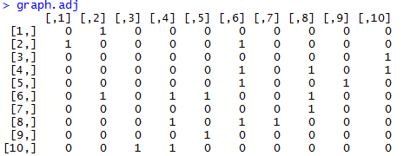
Generating an Arbitrary Graph
install.packages("sna")
trying URL 'https://cran.rstudio.com/bin/windows/contrib/3.2/sna_2.3-2.zip‘
Content type 'application/zip‘ length 847434 bytes (827 KB)
downloaded 827 KB
package ‘sna’ successfully unpacked and MD5 sums checked
The downloaded binary packages are in
C:\Users\Stephen Kaisler\AppData\Local\Temp\RtmpeiNN6E\downloaded_packages
library(sna)
sna: Tools for Social Network Analysis Version 2.3-2 created on 2014-01-13.
copyright (c) 2005, Carter T. Butts, University of California-Irvine
Type help(package="sna") to get started.
N = 10
plink = 0.3
graph.adj=rgraph(N,1,plink,"testgraph", FALSE)
2-<number>
Notes:
Graph.adj -> turns in to a matrix (adjacency matrix)

Slide 22
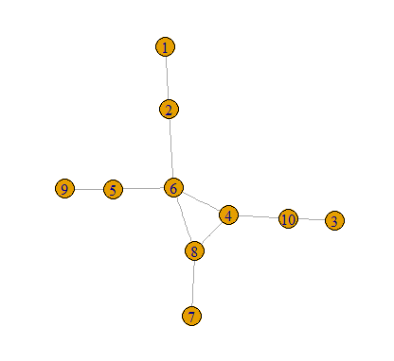
Converting to an igraph
2-<number>

Slide 23
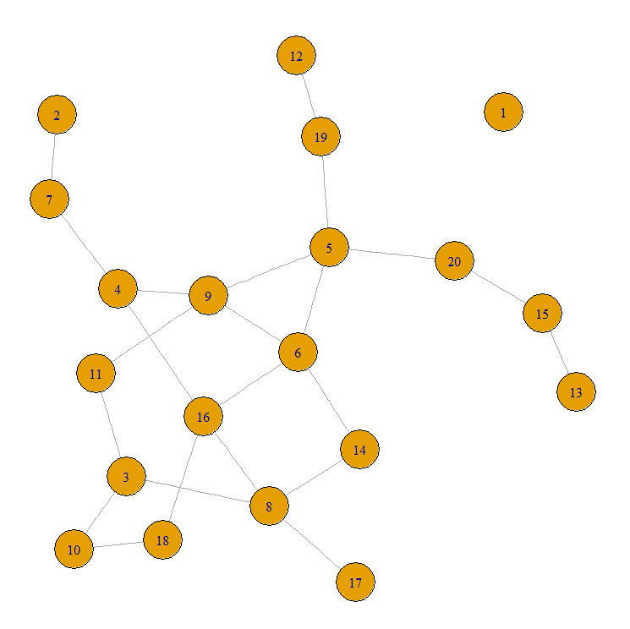
A Somewhat Larger graph
N = 20
plink = 0.1
2-<number>

Slide 24
Some Metrics - I
Density = # existing edges/ # possible edges
  A graph with higher density is more connected
  A higher density graph can resist more link failures (e.g., removals)
gden(graph.adj)
[1] 0.1210526
Connectedness: the fraction of all dyads (e.g., two nodes, u and v) such that there exists an undirected path from u to v
is.connected(graph)
[1] FALSE // some pairs of nodes are not connected
connectedness(graph.adj)
[1] 0.9
Note: sometimes we work with the igraph representation and sometimes with the rgraph representation
Different packages have different functions!!
2-<number>

Slide 25
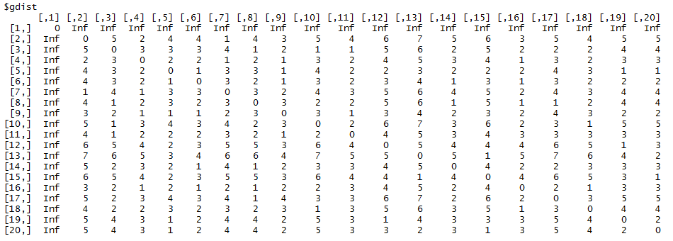
Some Metrics - II
A geodesic is the shortest path between any two nodes in the network.
A node has high betweenness if the geodesics between many pairs of other nodes pass through that node.
A node with high betweenness, when it fails or is removed, has greater influence on the connectivity of the network.
We can see that node 1 is not connected to anything (Inf hops)
Which nodes have the geodesics?
2-<number>

Slide 26
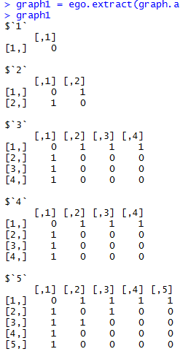
Some Metrics - III
An egocentric network of a vertex v is a subgraph consisting of v and its immediate neighbors.
The egocentric networks
of the first five vertices.
All such networks are
produced by the function.
2-<number>
Notes:
Use ego.exract

Slide 27
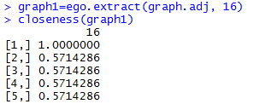
Some Metrics - IV
Closeness Centrality (CLC) is a measure defined for a given vertex. The higher the closeness, the closer the node is to other nodes in the graph.
It is the ratio of the total number of nodes in the graph minus one to the sum of the geodesics from v to every other vertex in the graph.
2-<number>

Slide 28
Social Network Analysis
A method based on formal graph theory that provides a set of techniques for analyzing the structure of networks where the linkages between the nodes are well-defined social relations (e.g., cooperation, enmity, trade), including multiple 1-to-1 relations (multiplex).
Used extensively in sociology, anthropology, and psychology in the study of human social networks.
Key Ideas:
  Network nodes are people (groups), links are relationships (contacts)
  Who is connected closely to whom (path length, clustering)?
  Who is key in the network (centrality)?
  Can we infer a large network structure from a very small amount of data (hidden networks, cells)?
2-<number>

Slide 29
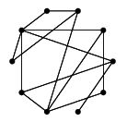

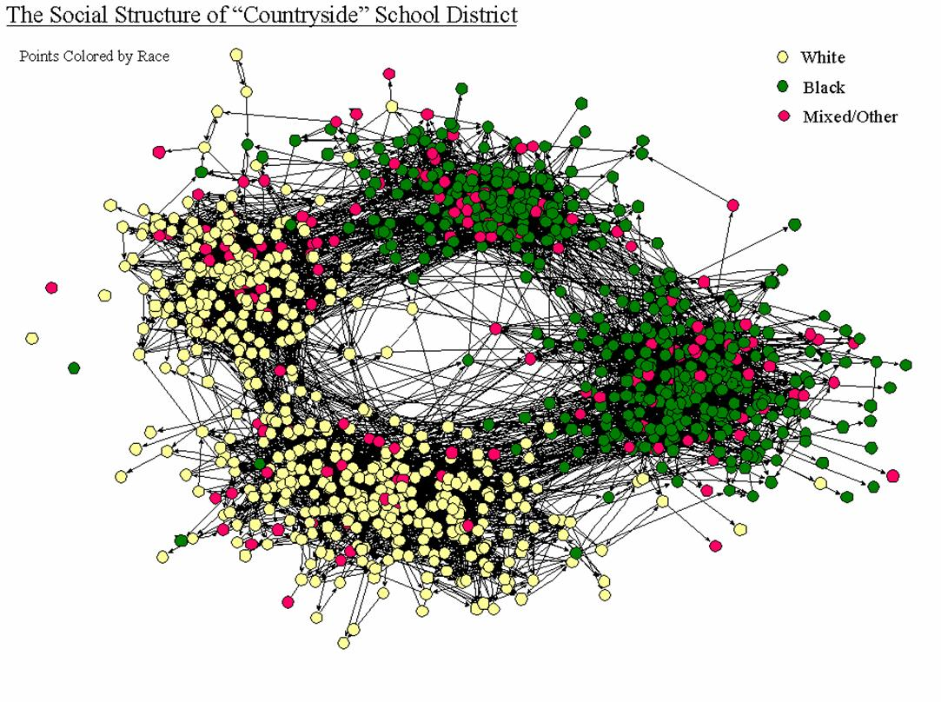
What is a Network?
Most empirical social networks are neither random …
nor regular
but complex …
Source: James Moody, 2000
2-<number>

Slide 30
Network Concepts - I
Node Properties:
  Fixed attributes
  Variable attributes (size, beliefs, opinions, capacity, goals, etc)
  Activation thresholds (critical fraction of neighbors in a particular state)
  Network location (centrality)
Centrality:
  Distinguishes “insiders” from “outsiders”; measures the impact of removing a node (and, perhaps, isolating a sub-network)
  Degree: number of links (to, from) a node.
  Closeness
    Takes into account not only node k’s degree but also the degree of k's neighbors.
    The reciprocal of the sum of geodesics between a node and other nodes.
  Betweenness: the number of geodesics that pass through a node.
2-<number>

Slide 31
Network Concepts - II
Edge: Direct link, tie, or “arc” connecting nodes
  Symmetric, undirected (e.g. marriage, alliance, warfare)
  Asymmetric, directed (e.g. employment, insurgency)
  Strength, value (e.g. frequency of interaction, weight)
  Valence (positive or negative influence on to node)
Network Properties:
  Connectivity -- how easy is it to get from one node to another?
    A graph is connected if every node is reachable from every other node
    Geodesic: If one node is reachable from the other, what is the shortest path between them?
    Kevin Bacon Game of 6 Degrees of Relationship, based on Stanley Milgram’s small-world discovery of six degrees of separation
  Mean geodesic: the average path length over all pairs of connected nodes.
  Redundancy: How many different paths connect each pair?
  Density: the number of paths divided by number of possible paths
2-<number>

Slide 32
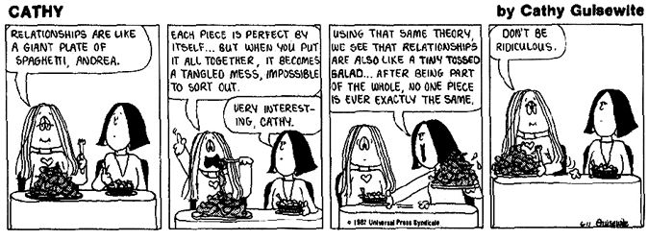
Network Concepts - III
Network Properties:
  Clustering: Given a group of nodes, the number of links between the nodes in the group is greater than the sum of the number of links to nodes outside the group
2-<number>

Slide 33
Why Study Social Networks?
Promotes understanding of complex interactions among similar or diverse entities treated as a group
Optimal organizing principles for functional specializations:
  Research
  Produce
  Distribute
  Manage
  Teach
Metrics fall out of graph theory
Importance of network effects in such systems
  How things are connected matters greatly
  Details of interaction matter greatly
  The metaphor of viral spread for information
  Dynamics of economic and strategic interaction
Both qualitative and quantitative; can be very subtle
2-<number>

Slide 34
Why Study Social Networks?
It is possible to build predictive models of individual and group behavior based on personality, culture, politics, and other related measures.
Most people exist in and make decisions based on the influence of many social networks, some of which coincide (i.e., members share more than one social context).
Decisions made in one context (e.g., work) are potentially not only influenced by those in the social network for the formal workplace, but the greater social network(s) spanning multiple contexts in the informal structure.
2-<number>

Slide 35
SNA Mapped to Flow Problems
Basic idea:
  Pairwise measures of social closeness represents the capacity of the potential influence between individuals (Borgatti, 1999)
  Social closeness, distance, similarities, or differences can be represented as capacities on the influence between individuals.
  Social closeness and similarities are defined to be strictly positive monotonic (greater magnitude implies greater influence).
  Social distance and differences are defined to be strictly negative monotonic (greater magnitude implies less influence).
2-<number>

Slide 36
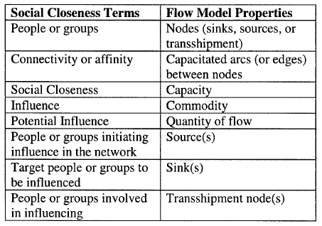
Taxonomy of Social Closeness Mapped to Flow Model
2-<number>

Slide 37
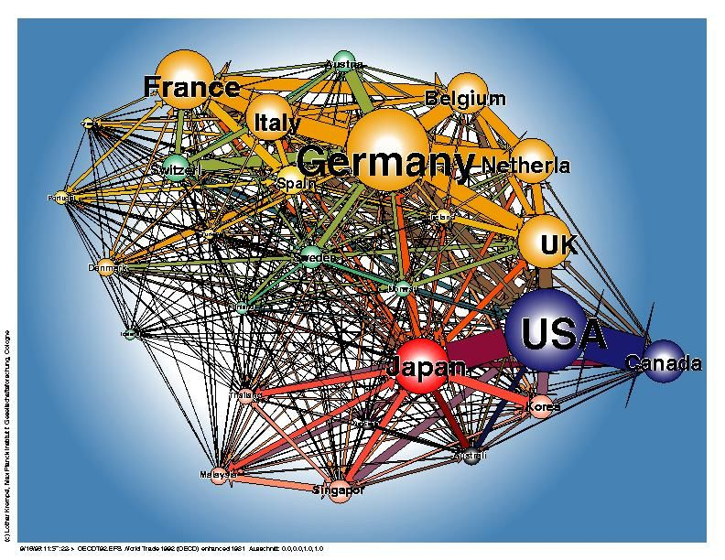
Social Network Analysis: Trade Analysis
Examine the Foreign trade of countries based on the types of products they import/export
Size of spheres is measure of trading volume
Problem: Need better tools to visualize the linkages and navigate through this complex network
Examine over time the fluctuations in the size of the spheres and the flows across the links
© Lothar Krempel. OECD Trade, 1992. New York Hall of Science.
2-<number>

Slide 38
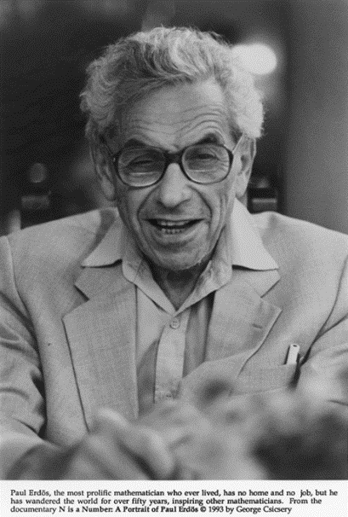
Social Network Analysis: Erdos Numbers
Explore Scientific Collaboration
Erdos Numbers: http://www.oakland.edu/enp/
  Distance of an author to a collaboration with Paul Erdos (d. 1996)
  Vertices: math and compsci researchers
  Had 507 co-authors
Rules:
  If you co-authored a paper with Erdos, your Erdos number is 1
  If you co-authored a paper with someone who authored a paper with Erdos, your number is 2
  My Erdos number is 4 or 5 depending on path
How does one navigate in such a network?
What does it tell us?
  Probably need to augment links with topics of papers
  Maybe also geolocations of co-authors
  Low Erdos numbers are possessed by many Fields Medalists and Nobel Prize Laureates
2-<number>

Slide 39
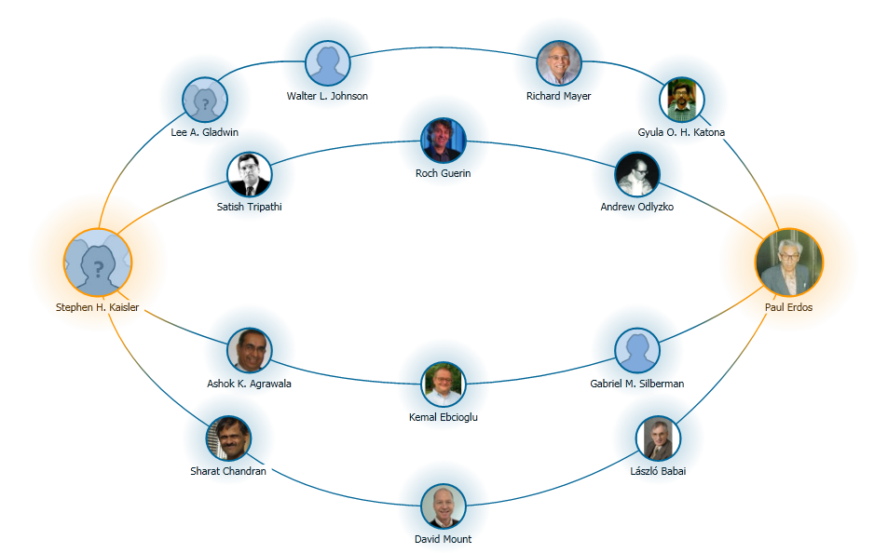
My Erdos Number
2-<number>

Slide 40
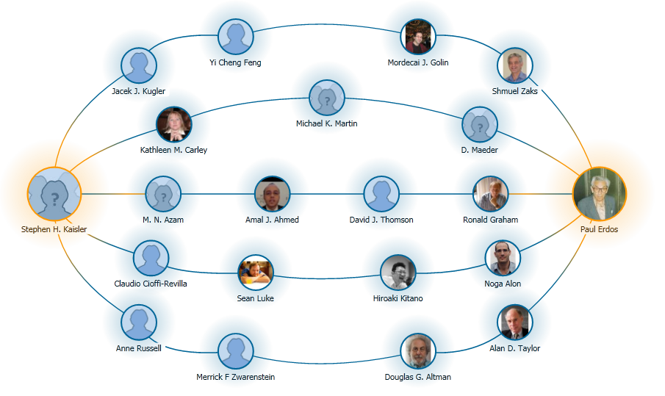
My Erdos Number
So, depending on your co-authors, you Erdos number varies.
2-<number>

Slide 41
SNA: Six Degrees of Kevin Bacon
A game based on the concept of “six degrees of freedom”, which posits that any two people on Earth are six or fewer acquaintance links apart.
Movie buffs challenge each other to find the shortest path between an arbitrary actor and prolific character actor Kevin Bacon.
The computation of a Bacon number for actor X is a "shortest path" algorithm, applied to the co-stardom network:
  Kevin Bacon himself has a Bacon number of 0.
  Those actors who have worked directly with Kevin Bacon have a Bacon number of 1.
  If the lowest Bacon number of any actor with whom X has appeared in any movie is N, X's Bacon number is N+1.
Here is an example, using Elvis Presley:
  Elvis Presley was in Change of Habit (1969) with Edward Asner
  Edward Asner was in JFK (1991) with Kevin Bacon
  Therefore, Asner has a Bacon number of 1, and Presley (who never appeared in a film with Bacon) has a Bacon number of 2.
According to the Oracle of Bacon website, approximately 12% of all actors cannot be linked to Bacon using its criteria.
2-<number>

Slide 42
Flow Model: Basic Ideas
Single commodity flow: influence
Source and sink nodes are individuals who exert or receive influence or both
Edges are drawn between individuals in a unidirectional manner with capacity assigned to eh edge based on perceived social closeness.
Social closeness comes from:
  Countings of communications over one or more means of communication (phone calls, faxes, emails, meetings, and so on)
  Elicited from people in the social network, or
  E.g., complex psychological profile based measures.
2-<number>

Slide 43
Iranian Government Model
Purpose: understand relative influence of selected individuals in the Iranian government.
Who among Iran's senior leaders has the greatest ability to influence the key Iranian government decision making bodies.
The individual with the maximum influence is a pressure point.
Consider this person as a target for a campaign to change his thinking
Data from: Foundation for Democracy in Iran (FDI) (http://www.iran.org).
FDI provides data for Iran in 1997 with regard to President Khatami's Cabinet, the Council of Expediency and Discernment, the Council of Guardians, the Judiciary Branch, the Majlis, and the Supreme National Security Council.
Some aggregation occurred to make the model simpler.
2-<number>

Slide 44
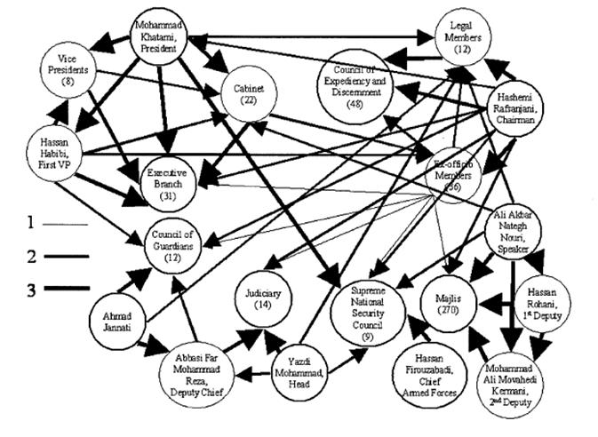
SNA: The Iranian Government Social Network
2-<number>

Slide 45
Iranian Government Model
Weight of edges is depicted by thickness of edge.
Social Closeness between members of a group they are primarily a member of are 3x that of only administrative connections.
Secondary group membership is 2x as important
as administrative connections.
Therefore, there is a ratio of 1:2:3 for administrative:secondary:primary connections.
Edges are directed based on the rules that:
  (1) people influence other people and groups down their chain-of command, and
  (2) groups influence other groups.
2-<number>

Slide 46
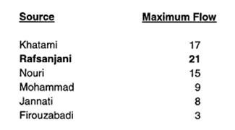

SNA: Influence Example
But, when Renfro and Deckro computed the weighted influence subject to maximizing z – the maximum flow – subject to:
Σ_{j} x_{sj} – z = 0
Σ_{j} x_{ij} – S_{j} x_{ji} = 0 for all i
z - Σ_{i} x_{it} = 0
0 <= x_{ij} <= s_{ij} for all i,j
using the formula for social closeness:
  s_{ij} = a(s_{kl}), a > 0, i /= j, k /= l
2-<number>

Slide 47
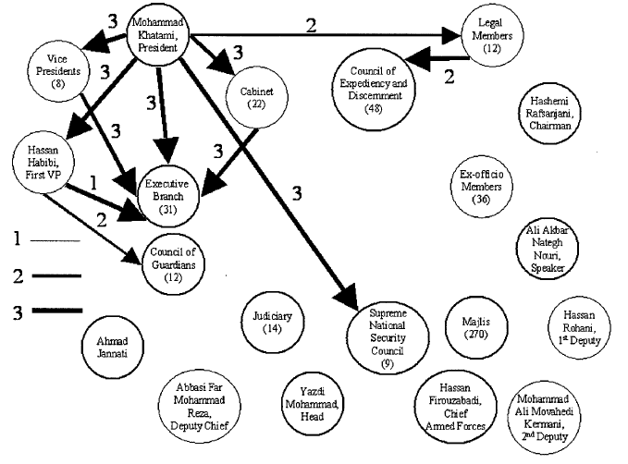
Maximum Flow Solution
2-<number>

Slide 48
But ….
Observe that Rafsanjani was:
  once the President of Iran, a member of or closely associated with all of the major governmental departments,
  and likely informally retains some or all those membership ties.
Further, observe that Khatami served under Rafsanjani when he was President.
Update the model using this additional contextual data and recalculate the flow.
Additional notional edges have been added to represent Rafsanjani's influence in the informal context
2-<number>

Slide 49

Revised Maximum Flow Model
2-<number>

Slide 50

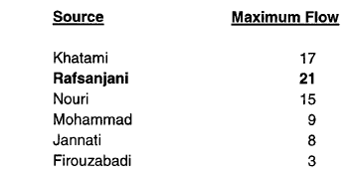
Rafsanjani’s Influence
These results indicate that Rafsanjani
actually has a greater potential to influence key Iranian government decision-making bodies than Khatami.
This result implies that targeting Rafsanjani would result in a greater potential to influence the decisions of the Iranian government than targeting any
other individual senior Iranian leader.
2-<number>

Slide 51
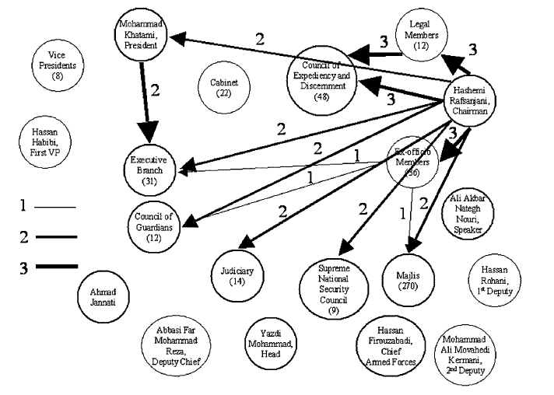
Revised Maximum Flow Solution
2-<number>

Slide 52
SNA: Centrality
Centrality:
  A stratification measure
  How to measure "power"
Does success depend on local or distal connections?
Does success depend on the power/centrality of other actors/vertices to which a focal vertex is connected?
Do resources “flow through” intermediary nodes, so that indirect relationships become proxies for direct ones?
Or is centrality more in the way of an indicator of exchange opportunities/bargaining power?
What are the “rules of the game” as regards the activation of multiple relationships?
2-<number>

Slide 53
Graphs & Networks: Challenges
Problem: static algorithms over dynamic graphs do not perform very well; need new algorithms
Problem: sparse graphs are often recast as sparse matrices or sets of sparse linear equations
  Just shift the computational burden
Problem: labeling graph nodes and edges with domain information
Problem: sampling a dynamic graph/network at fixed intervals – what can we learn?
Problem: multiple edges connecting nodes lead to multiple paths through the graph? How does the number of paths increase?
Problem: merging or splitting graphs; what are the criteria?
(Equivalent to the Merge Problem in Ontologies)
2-<number>

Slide 54
Social Network Analysis: Challenges
Can be hard to observe relations. You can interview friends, but you cannot interview a friendship, so:
  Measure and aggregate attributes of individuals.
  Model social life as correlations among individual attributes (e.g. age, race, gender, education, income)
Challenges for current tools and techniques:
  Accounting for missing or erroneous data
  Modeling dynamic changes in network structure (diachronic change)
  Modeling key flows, identify key players
  Detecting vulnerabilities
  Performing what-if analyses
SNA is largely based on graph theory which today exists at the nexus of topology and combinatorics
2-<number>

Slide 55
Key References
Wasserman, Stanley, and Katherine Faust. 1994. Social Network Analysis: Cambridge University Press.
Scott, John. 2000. Social Network Analysis: A Handbook. London: Sage Publications.
Bienenstock, Elisa J., and Phillip Bonacich. 2003. Balancing Efficiency and Vulnerability in Social Networks. In Dynamic Social Network Modeling and Analysis: Summary and Papers, edited by R. Breiger, K. Carley and P. Pattison. Washington, D.C.: National Academies Press.
Cioffi-Revilla, Claudio. 1979. Diplomatic communications theory: Channels, signals and networks. International Interactions 6 (3):209-265.
Gould, Roger V. 2003. Uses of Network Tools in Comparative Historical Research. In Comparative Historical Analysis in the Social Sciences, edited by J. Mahoney and D. Rueschemeyer. Cambridge, UK: Cambridge University Press.
Tsvetovat, Maksim, and Kathleen Carley. 2006. On Effectiveness of Wiretap Programs in Mapping Social Networks. Computational and Mathematical Organization Theory.
Koschade, Stuart. 2006. A Social Network Analysis of Jemaah Islamiyah: The Applications to Counterterrorism and Intelligence. Studies in Conflict and Terrorism 29 (6):589–605.
Barabasi, Albert-Laszlo. 2002. Linked: The New Science of Networks. Cambridge: Perseus Publishing.
Easley, D. and J. Kleinberg. 2010. Networks, Crowds, and Markets. Cambridge University Press, Cambridge, England, available at: http://www.cs.cornell.edu/home/kleinber/networks-book/networks-book.pdf
Renfro, R.S. II and R. F. Deckro. 2003. “A Flow Model Social Network Analysis of the Iranian Government”, Military Operations Research, 8(1):5-16.
2-<number>

